Slide 1

18CSC302J- Computer Networks
Unit-3
School of Computing - SRMIST Kattankulathur Campus

Slide 2
Syllabus
DNS- DNS in the Internet, DNS Resolution, DNS Messages
TELNET - SSH
Full Duplex Chat Using TCP/IP
FTP- TFTP
WWW Architecture, Documents
HTTP, HTTP Request and Reply,
Implementation of File Transfer Protocol
DHCP Operation, DHCP Configuration
SMTP, POP3, IMAP, MIME
Remote Command Execution Using UDP
Learning Resources
1. Douglas E. Comer, Internetworking with TCP/IP, Principles, protocols, and architecture,Vol 1 5th Edition,2006 ISBN: 0131876716, ISBN: 978-0131876712
*Lab exercises are highlighted

Slide 3
DNS(Domain Name System)
TCP/IP protocols uses IP address.
Identifies connection of a host to the internet.
System maps a name to an address
Host file – only two columns (name, address)
Single host file – maps the names to address
Host file would be large to store in every host.
Impossible to update the changes happens every time to the host file.
Solution 1
Store the host file in a single system and allow the centralized information access to every system that needs mapping.
Disadvantage
Huge amount of traffic to the internet.
Solution 2
Divide the huge amount of information into smaller parts and store on different systems.
Host which needs mapping can communicate to the closest system that holds the information.
This solution is called Domain Name System.
18CSC302J- School of Computing (Odd sem 2020)

Slide 4
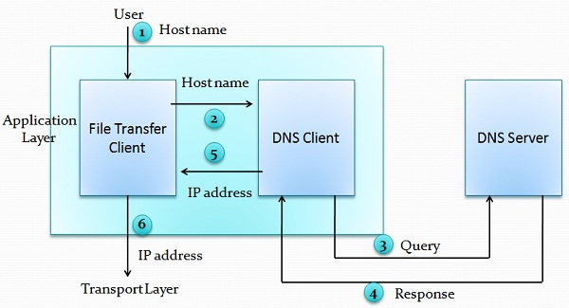
Purpose of DNS
Six steps to map host name to an IP address
User passes the host name to the file transfer client (FTC).
FTC passes the host name to DNS client.
DNS client sends a message to the DNS Server. The query gives the file transfer server name using the known IP address of the DNS server.
DNS server responses back with the IP address of the desired file transfer server.
DNS client passes the IP address to file transfer server.
FTC uses the IP address it received to access the file transfer server.
Two Connections must be made
Mapping the name to an IP address
Transferring files

Slide 5
Namespace
Maps the address to the unique names.
Organized in two ways flat or hierarchical.
Flat Name Space
Name is assigned to an address, name is the sequence of characters without structures.
Disadvantage
Cannot used in large system.
Centrally controlled to avoid ambiguity and duplications.
Hierarchical Name Space
Each name is made up of several parts.
First part – nature of organization
Second part – name of an organization
Third part – departments in the organization
Namespace can be decentralized.
Suffixes (or prefixes) are added to the name that defines the host or system.

Slide 6
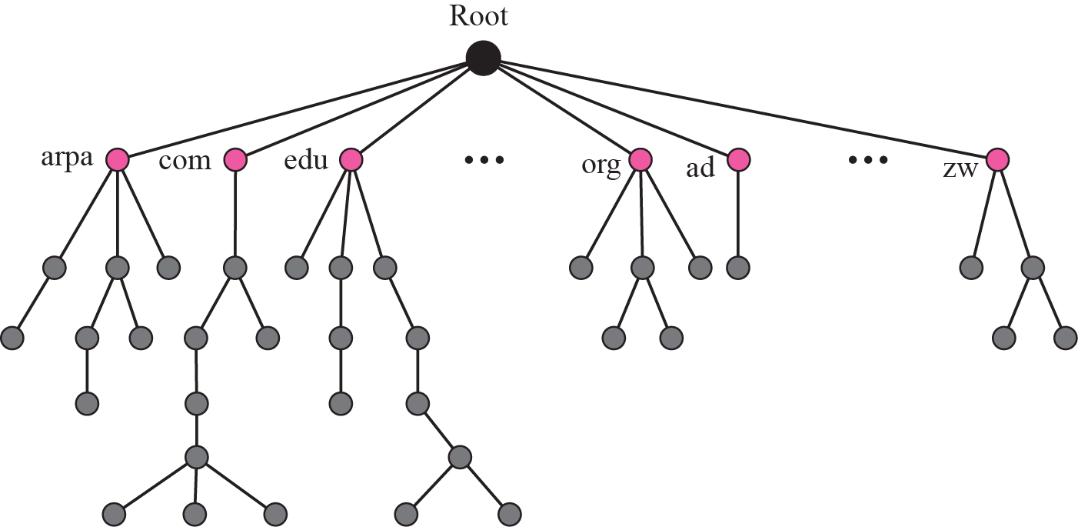
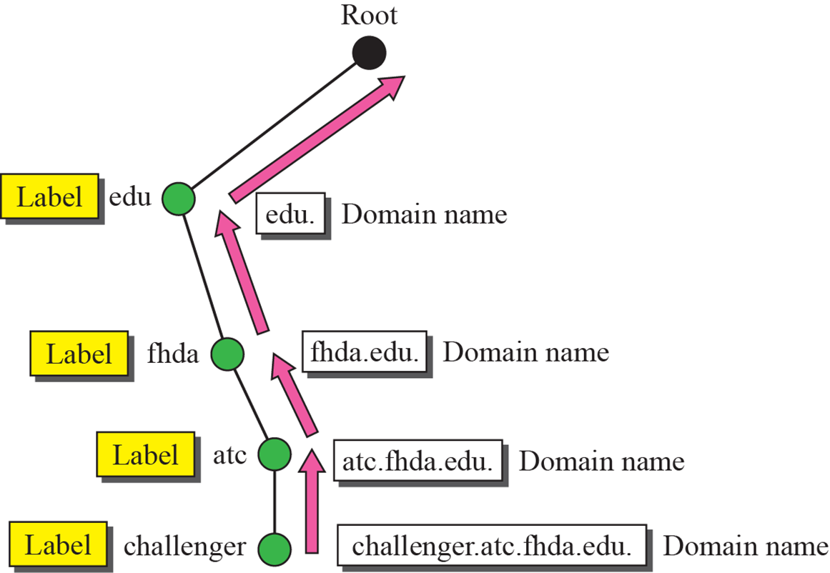
Domain Name Space
Hierarchical name space – DNS was designed.
Names are defined in inverted tree structure with root at top.
Tree have 128 levels – 0 (root) to 127.
Label
Each node in a tree has a label – max of 63 characters.
Root label is a null string.
Children node should have different labels that will ensure uniqueness in domain names.
Domain Name
Full domain name is the sequence of labels separated by dots.
Domain names read from nodes up to the root.
Full domain name always ends in a null label.
Domain Name System
Domain names and labels

Slide 7
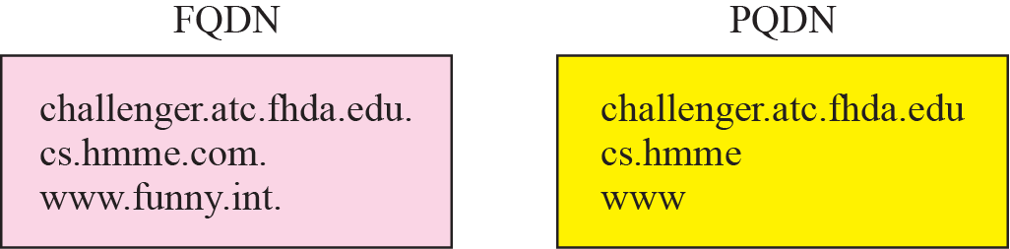
Fully Qualified Domain Names (FQDN) Partially Qualified Domain Names (PQDN)
Fully Qualified Domain Names (FQDN)
If the label is terminated by null string it is called fully qualified domain names.
Contains the full name of the host, contains all labels from most specific to most general.
DNS server can match an FQDN to an address.
Eg: challenger.atc.fhda.edu.
Partially Qualified Domain Names (PQDN)
If the label is not terminated by null string it is called partially qualified domain name.
PQDN starts from the node but does not reach the root.
The resolver will supply the missing part called the suffix to create a PQDN.
User at fhda.edu site wants to get the IP address of the challenger computer, has to mention the partial name.
Eg: challenger
The DNS client adds the suffix before parsing the address to the DNS server.
Eg: act.fhda.edu
FQDN and PQDN

Slide 8
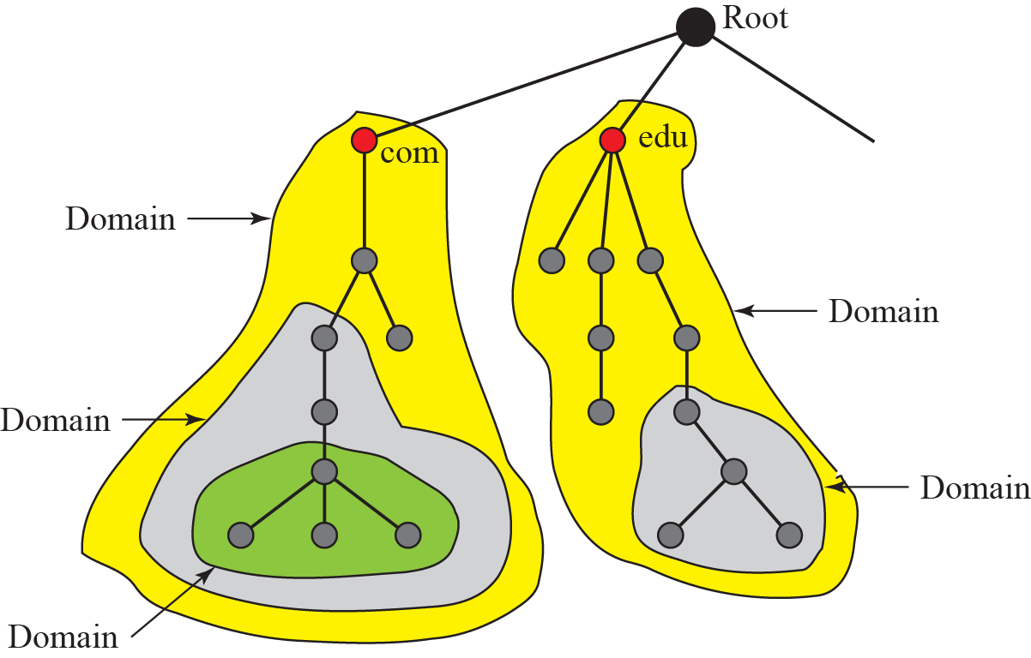
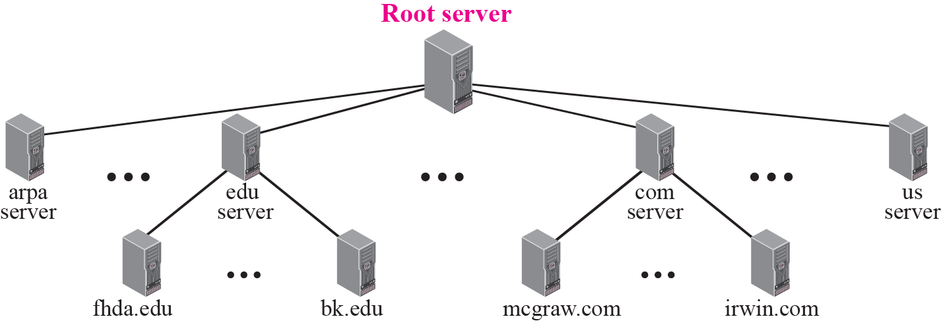
Domain Name Space
Domain
It is the subtree of domain name space.
The of the domain is the name of the node at the top of the subtree.
Domains may itself divided into sub domains.
Distribution of name space
Information in the namespace must be stored.
It is inefficient and not reliable to store the information in a single system.
Solution
Distribute the information among many computers called DNS servers.
Hierarchy of name space
Divide the whole space into many domains based on the first level.
Domains
Hierarchy of name servers

Slide 9
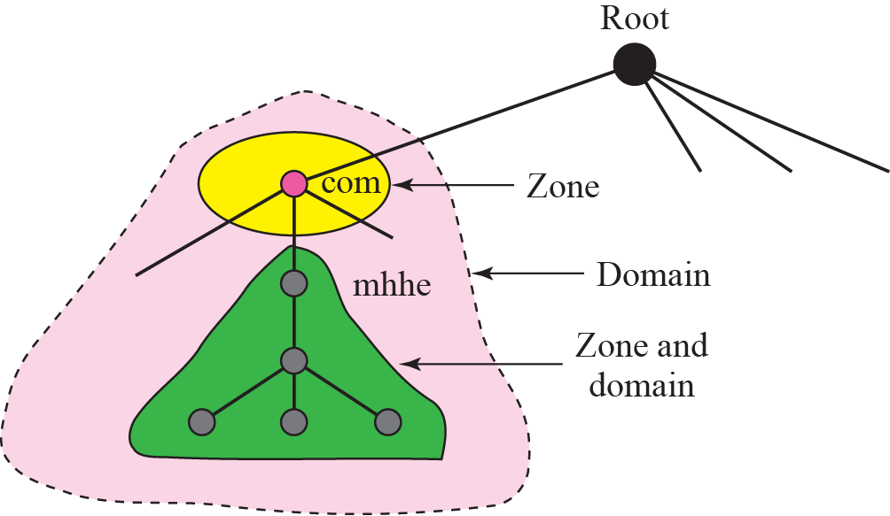
Domain Name Space
Zone
What a server is responsible for or has authority over is called zones.
Zone is the contiguous part of the entire tree.
If server accepts the responsibility for a domain and does not divide the domain into smaller domains then “domain” and “zone” refers the same thing.
Root server
It is the server whose zone consists of the whole tree.
It does not store any information about the domains but delegates the authority to other servers, keeping references to those servers.
Zones and Domains

Slide 10
Domain Name Space
Primary and Secondary Servers
Primary Server
Server that stores the file about the zone for which it is in authority.
It is responsible for creating, maintaining and updating the zone files.
It stores zone file on a local disk.
Secondary Servers
Server that transfers the complete information about zone from another server and stores the file on its local disk.
Secondary server neither creates nor updates the zone files.

Slide 11
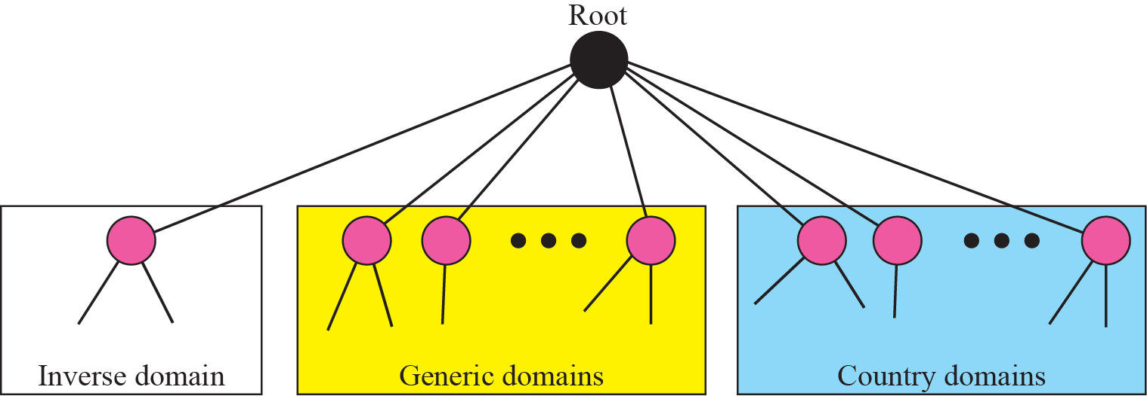
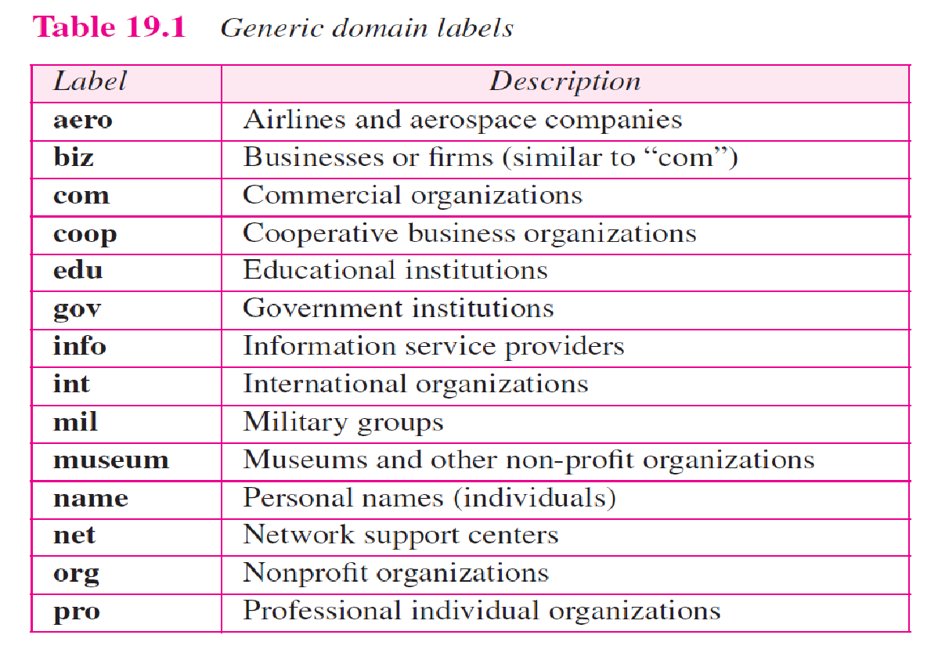
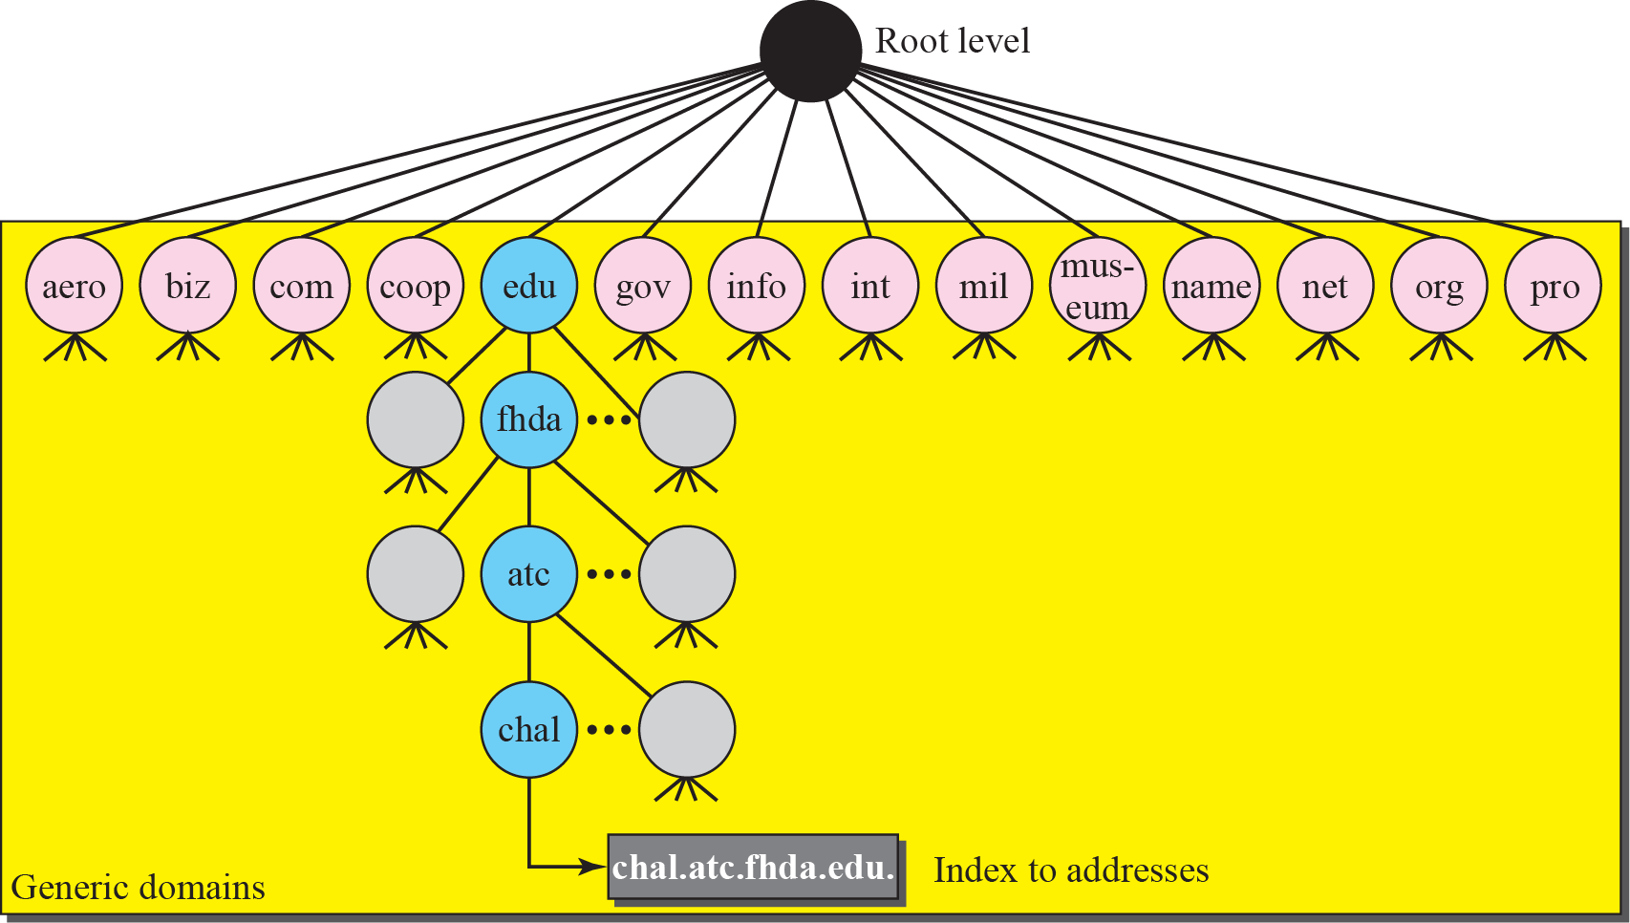
DNS in the Internet
In internet the domain name space is divided into three different sections.
Generic domains, country domains and the inverse domains.
Generic Domains
Define registered hosts according to their generic behaviour.
Each node in a tree defines a domain which is an index to the domain name space database.
DNS used in internet
Generic Domain Labels
Generic Domains

Slide 12
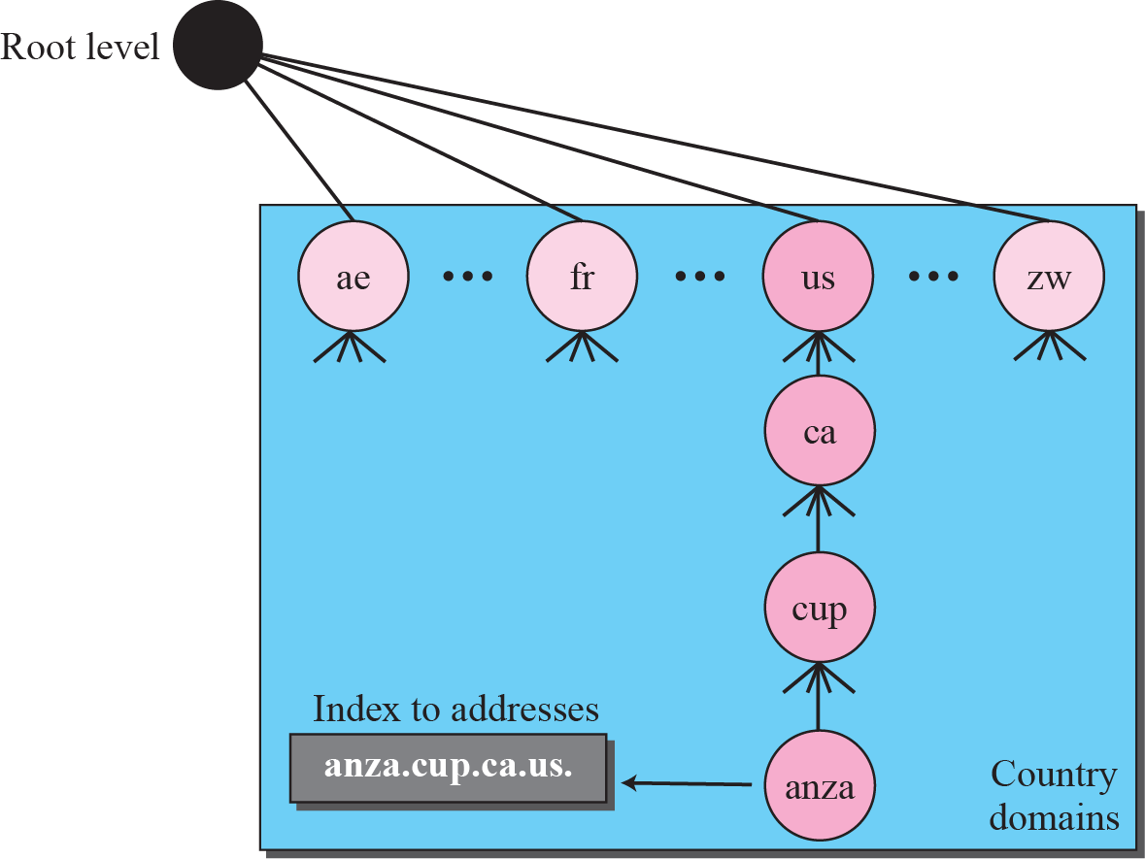
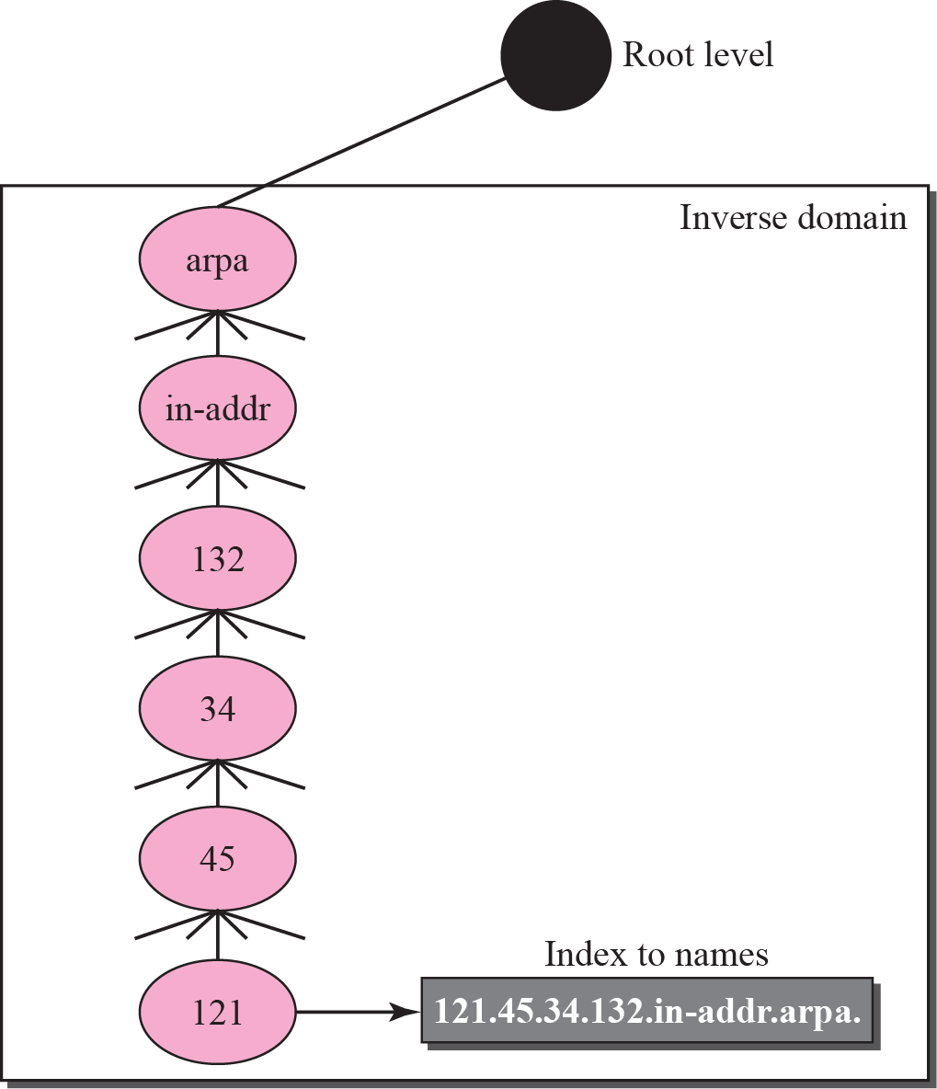
DNS in the Internet
Country Domains
Uses two character country abbreviations.
Eg: US for United Sates
Second label can be organizational or they can be more specific national designations.
Eg: ca.us
Inverse Domain
It is used to map an address to a name.
This happens when the server has received a request from the client.
Type of query called an inverse or pointer (PTR) query.
To handle the pointer query the inverse domain is added to the domain name space with the first level node.
Second level is also one single node named in addr (for inverse address).
Country Domains
Inverse Domain

Slide 13
Resolution
Mapping a name to an address or an address to a name is called name address resolution.
Resolver
DNS is designed as a client – server application.
Host that needs to map an address to a name or a name to an address calls a DNS client called a resolver.
After the resolver receives the mapping, it interprets the response to see if it is a real resolution or an error and finally delivers the results to the process that requested it.
Mapping Names to Addresses
The resolver gives a domain name to the server and asks for the corresponding address.
If the domain name is from the generic domain the resolver receives a domain name such as “chal.atc.fhda.edu.
if the domain name is from the country domain the resolver receives a domain name such as “ch.fhda.cu.ca.us.

Slide 14
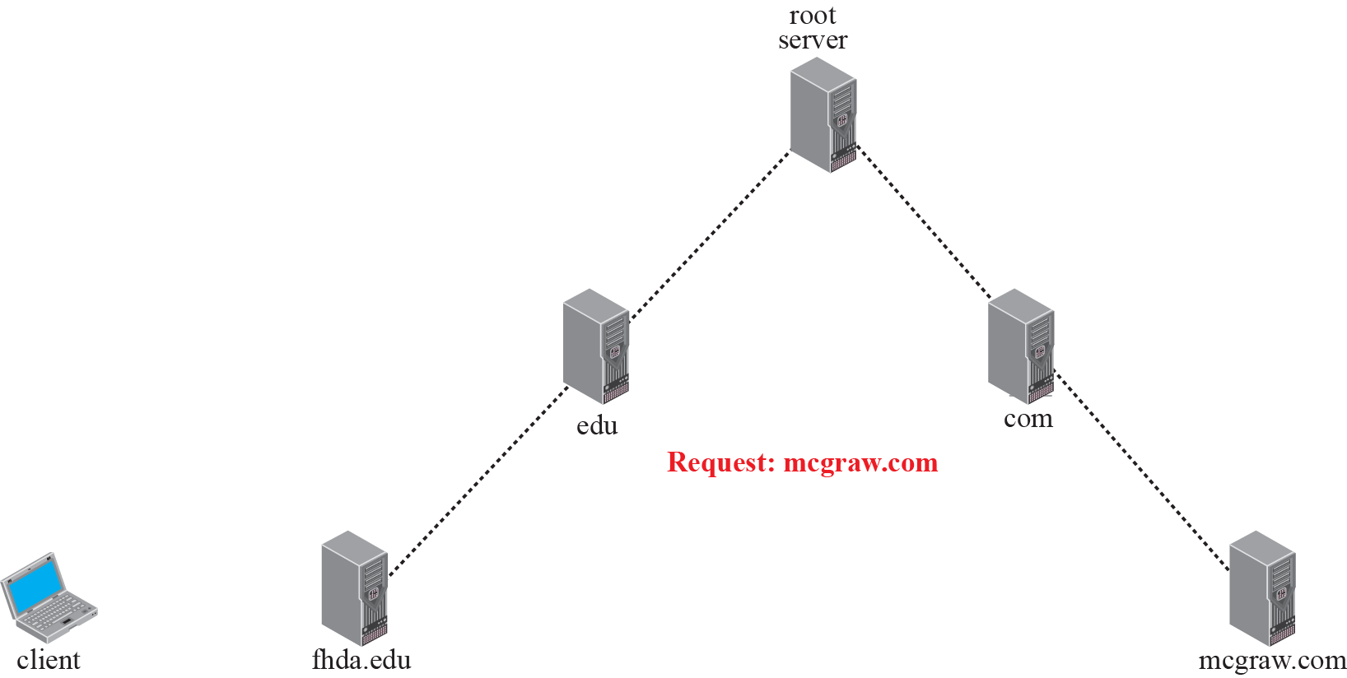
Resolution
Mapping Addresses to Names
A client can send an IP address to a server to be mapped to a domain name.
To answer the PTR query DNS uses the inverse domain.
in the request the IP address is reversed and two labels in-addr and arpa are appended to create a domain acceptable by the inverse domain.
Recursive Resolution
The client can ask for a recursive answer from a name server.
If the server is the authority for the domain name, it checks its database and responds.
If the server is not the authority it sends the request to another server and waits for the response.
If the parent is the authority it responds otherwise it sends the query to another server.
Recursive resolution

Slide 15
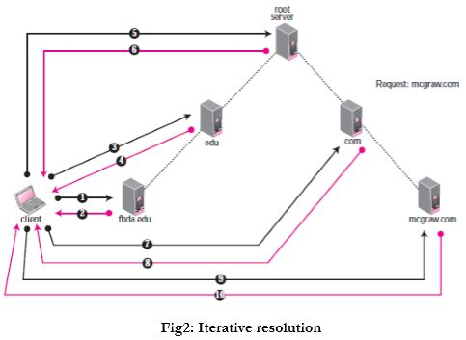
Resolution
Iterative Resolution
If server is an authority for the name it sends the answer.
If not it returns the IP address of the server that thinks it can resolve the query.
The client is responsible for repeating the request to the second server.
The client repeats the same procedure to next server and so on
This process is called iterative because the client repeats the same query to multiple servers.
Catching
Each time the server receives the query for a name that is not in domain it needs to search its database for a server IP address.
Reduction in search time would increase the efficiency.
DNS handles this with the mechanism called catching.
Iterative Resolution

Slide 16
Resolution
Reduction of search time would increase the efficiency.
DNS handles this with the mechanism called catching.
Catching speeds up resolution but it can also be problematic.
If the server catches the mapping for a long time it may send an outdated mapping to the client.
Two counter techniques are used
The authoritative server always adds information to the mapping called time to live.
DNS requires each server keep a TTL counter for each mapping it caches.

Slide 17
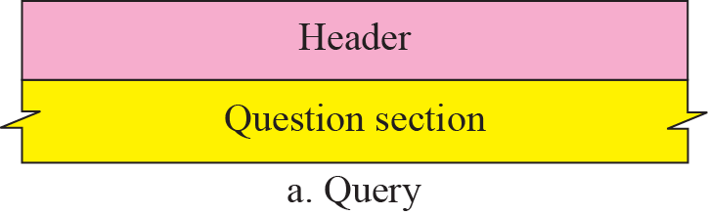
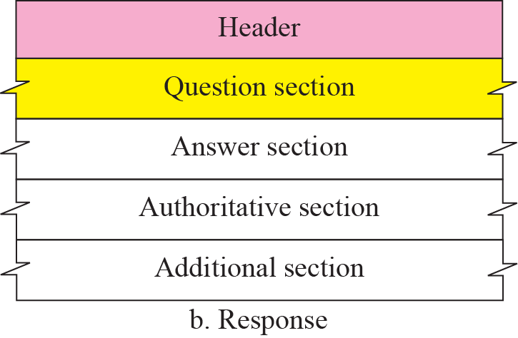
DNS Messages
DNS messages are of two types
Query
Response
The query message consists of header and question records.
The response message consists of header, question records, answer records, authoritative records and additional records.
Query and Response Messages

Slide 18
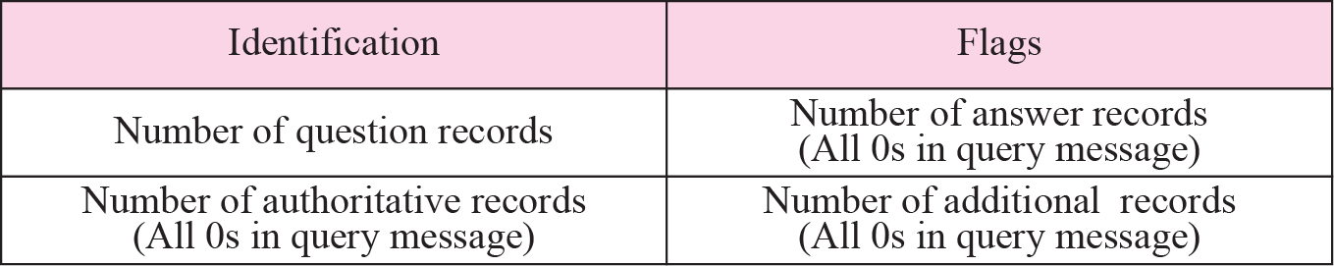
DNS Messages
Header
Both query and response message have the same header format with some fields set to zero for query messages.
The header is of 12 bytes.
Identification - 16 bit field used by client to match the response with the query.
Flags – 16 bit field consisting of the subfields.
QR (Query/Response) – 1 bit sub field defines type of message.
0 – message is query
1 – message is response
OpCode - 4 bits, defines the type of query or response
0 – standard
1 – inverse
2 – server status request
Header Format
Flags Field

Slide 19
DNS Messages
AA (Authoritative Answer) – 1 bit subfield
Set to 1 - name server is the authoritative server
Used only in response message.
TC (Truncate) – 1 bit subfield
Set to 1 – response was more than 512 bytes and truncated
It is used when DNS uses the services of UDP
RD (Recursion Desired) – 1 bit subfield
Set to 1 – client desires a recursive answer
It is set in query message and repeated in the response message
RA (Recursion Available) – 1 bit subfield
Set in response, means that a recursive response is available
Set only in response message
Flags Field

Slide 20
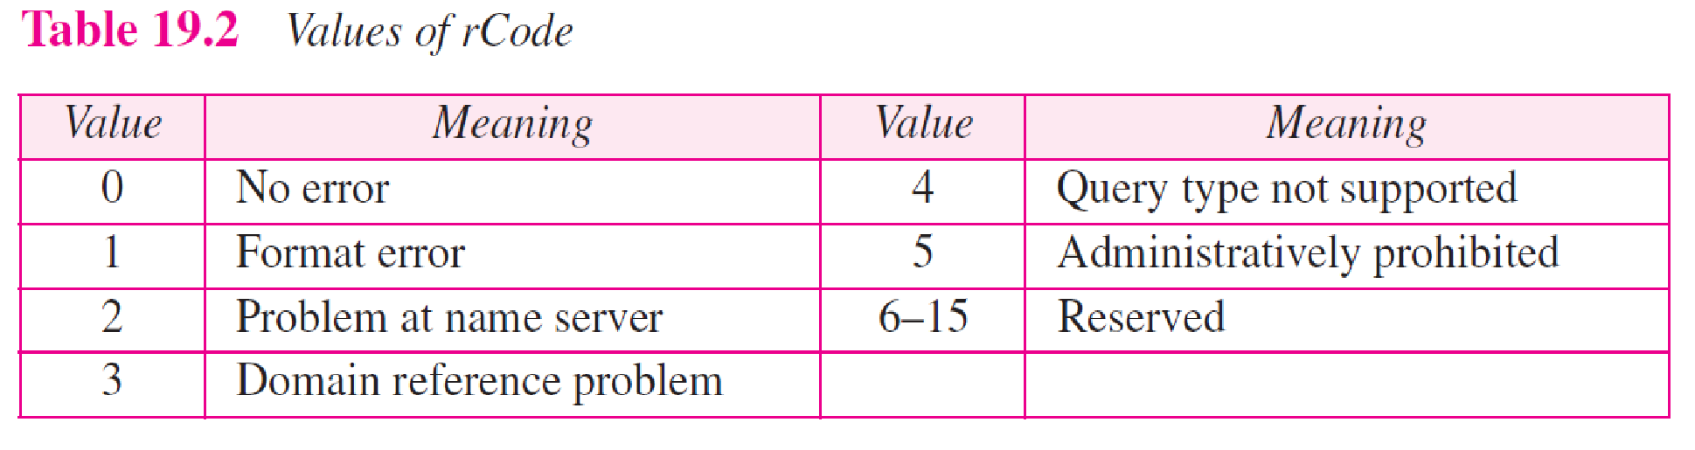
DNS Messages
Reserved – 3 bit sub field set to 000.
rcode – 4 bit field shows status of error in response
Only authoritative server can make the judgement
Number of question records – 16 bit field
Contains the number of queries in question section of the message
Number of answer records – 16 bit field
Contains the number of answer records in answer section of the response message
Number of authoritative records – 16 bit field
Contains number of authoritative records in authoritative section of the response message
It’s value is zero in query message
Number of additional records – 16 bit field
Contains number of additional records in additional section of a response message
Flags Field
Values of rcode

Slide 21
DNS Messages
Question Section
Consists of one or more question records
It is present in both query and response messages
Answer Section
Consists of two or more resource records
It is present only on response messages
Authoritative Section
Consists of two or more resource records
It is present only on response messages
Gives information (domain name) about one or more authoritative servers for the query
Additional Information Section
Consists of two or more resource records
It is present only on response messages
Gives additional information that helps the resolver

Slide 22
TELNET & SSH

Slide 23
TELNET
TErminaL NETwork –remote login
standard TCP/IP protocol for virtual terminal service as proposed by ISO.
TELNET enables the establishment of a connection to a remote system in such a way that the local terminal appears to be a terminal at the remote system.
TELNET is a general-purpose client-server application program
Concepts
Timesharing Environment
All of the processing must be done by the central computer. When a user types a character on the keyboard, the character is usually sent to the computer and echoed to the monitor. It creates an environment in which each user has the illusion of a dedicated computer.

Slide 24
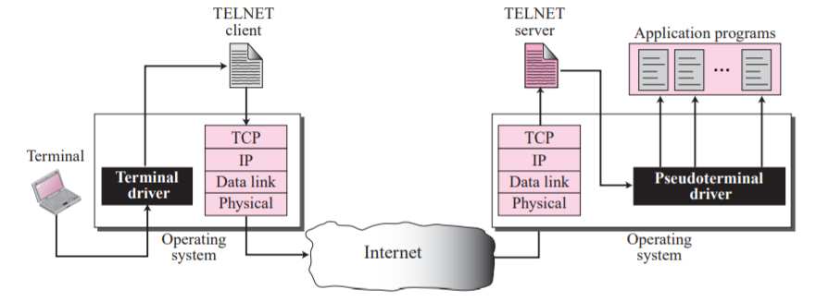
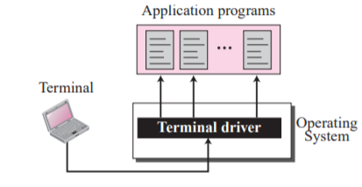
Login
Local login
Remote Login

Slide 25
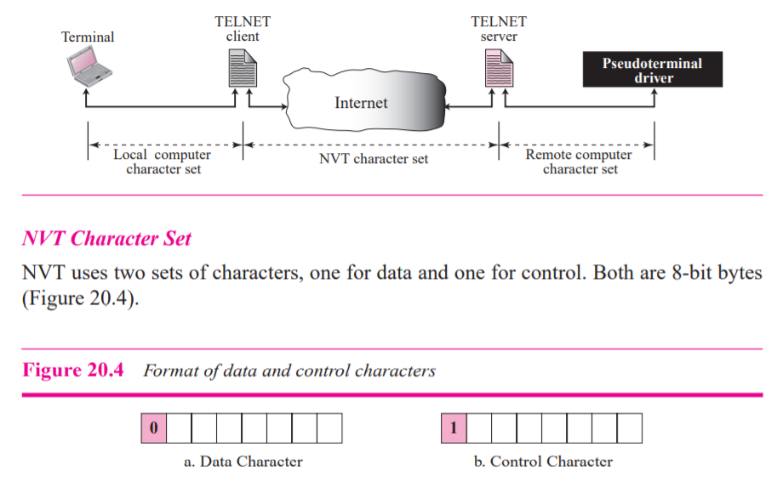
b) Network Virtual Terminal (NVT)
Heterogeneous networks
remote computer- type of the computer to be known
The client TELNET translates characters (data or commands) that come from the local terminal into NVT form and delivers them to the network.
The server TELNET, on the other hand, translates data and commands from NVT form into the form acceptable by the remote computer.

Slide 26
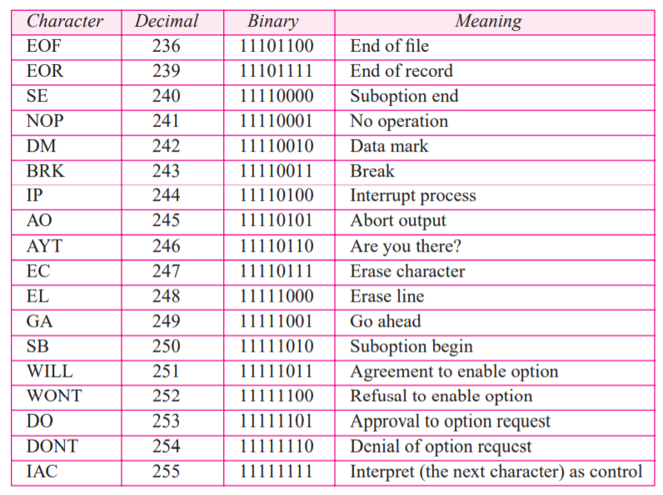
NVT Character Set
Data Characters called NVT ASCII.
This is an 8-bit character set in which the seven lowest order bits are the same as US ASCII and the highest order bit is 0
Although it is possible to send an 8-bit ASCII (with the highest order bit set to be 0 or 1)-must first be agreed upon between the client and the server using option negotiation.
To send control characters between computers (from client to server or vice versa), NVT uses an 8-bit character set in which the highest order bit is set to 1

Slide 27
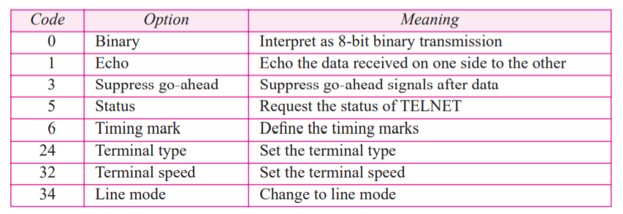
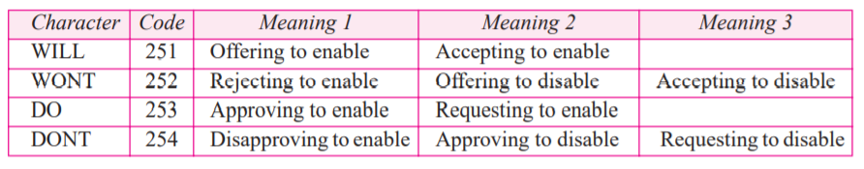
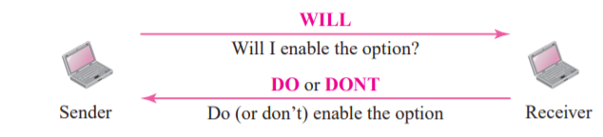
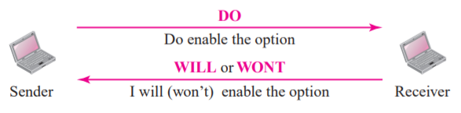
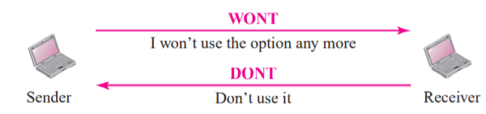
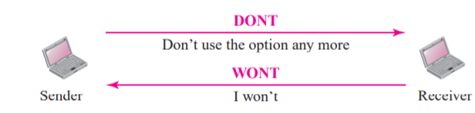
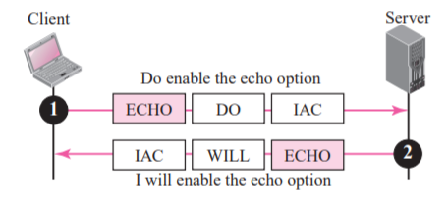
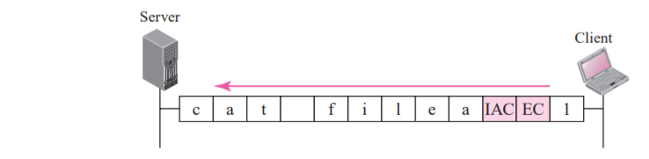
c) Embedding
Options
TELNET uses only one TCP connection.
The server uses the well-known port 23 and the client uses an ephemeral port. Same connection is used for sending both data and control characters.
TELNET accomplishes this by embedding the control characters in the data stream.
To distinguish data from control characters, each sequence of control characters is preceded by a special control character called interpret as control (IAC).
For example, imagine a user wants a server to display a file (file1) on a remote server.
cat file1
cat filea1
NVT character set for option negotiation
Backspace characters

Slide 28
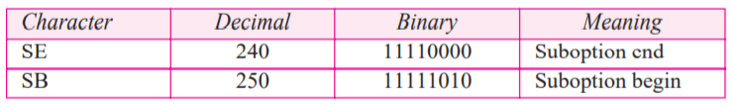
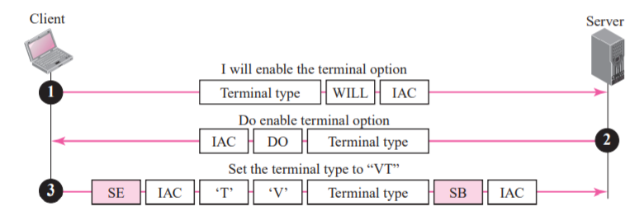
d)Symmetry
the client and server are given equal opportunity
both are using a default TELNET implementation with no options enabled.
If one party wants an option enabled, it can offer or request. The other party has the right to approve the offer or reject the request if the party is not capable of using the option or does not want to use the option.
This allows for the expansion of TELNET. A client or server can install a more sophisticated version of TELNET with more options.
When it is connected to a party, it can offer or request these new options.
If the other party also supports these options, the options can be enabled; otherwise, they are rejected.
NVT character set for sub option negotiation
To define the type or speed of a terminal, the negotiation includes a string or a number to define the type or speed

Slide 29
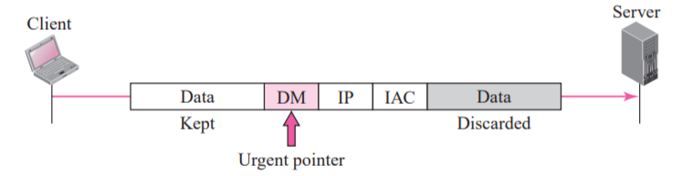
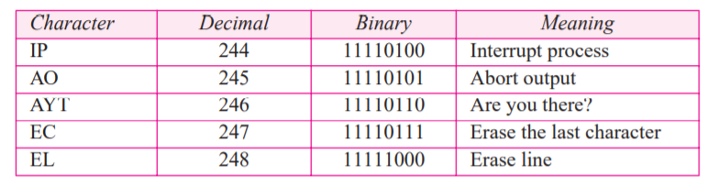
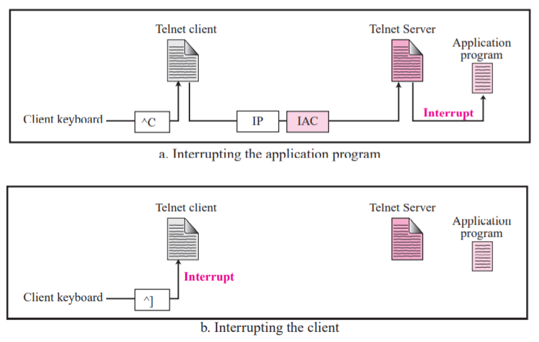
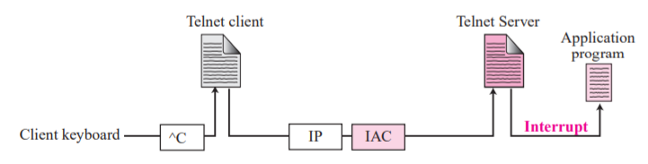
e) Controlling Server Characters used to control a program running on remote server
f) Out of Band Signalling
Two different interruptions
Interrupting an application program

Slide 30
Mode of Operation
(i) Character Mode- overhead created
The user enters a character that is sent to the server
The server acknowledges the received character and echoes the character back (in one segment).
The client acknowledges the receipt of the echoed character.
(ii) Linear Mode
Echoing, character erasing, line erasing, and so on) is done by the client.
The client then sends TELNET AND SSH 623 the whole line to the server. Although the line mode looks like the default mode, it is not.
The default mode operates in the half-duplex mode; the line mode is full-duplex with the client sending one line after another, without the need for an intervening GA (go ahead) character from the server.

Slide 31
C) Default mode
Used if no other modes are invoked through option negotiation.
In this mode, the echoing is done by the client.
The user types a character and the client echoes the character on the screen (or printer) but does not send it until a whole line is completed.
After sending the whole line to the server, the client waits for the GA (go ahead) command from the server before accepting a new line from the user.
The operation is half-duplex.
Half-duplex operation is not efficient when the TCP connection itself is full-duplex, and so this mode is becoming obsolete.

Slide 32
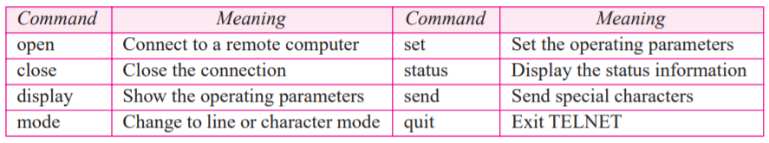
Interface Commands
TELNET suffers from security problems.
Although TELNET requires only a login name and password (when exchanging text)
For instance: A microcomputer connected to a broadcast LAN can easily eavesdrop using snooper software and capture a login name and the corresponding password (even if it is encrypted)

Slide 33
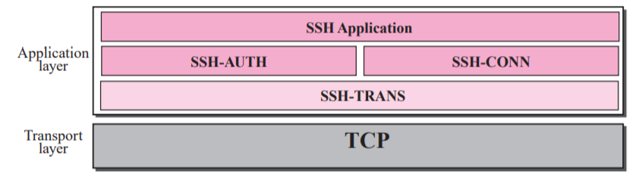
Secure Shell (SSH)
remote login application program
Like TELNET, uses TCP as the underlying transport protocol
SSH is more secure and provides more services than TELNET
Versions - two versions of SSH: SSH-1 and SSH-2, which are totally incompatible. SSH-1 is now deprecated because of security flaws in it. Now SSH-2 only used.

Slide 34
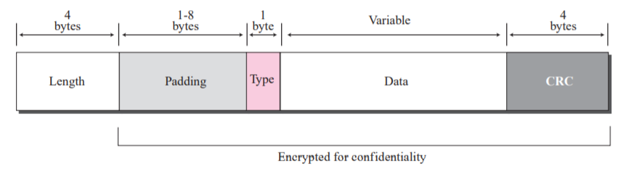
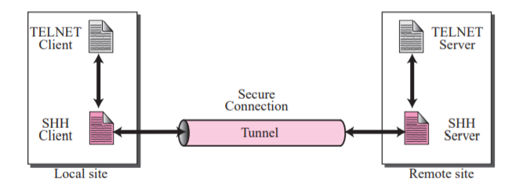
SSH Packet Format
Port Forwarding
Length. This 4-byte field defines the length of the packet including the type, the data, and the CRC field, but not the padding and the length field.
Padding. One to eight bytes of padding is added to the packet to make the attack on the security provision more difficult.
Type. This one-byte field defines the type of the packet used by SSH protocols.
Data. This field is of variable length. The length of the data can be found by deducting the five bytes from the value of the length field.
CRC. The cyclic redundancy check filed is used for error detection

Slide 35
FTP & TFTP

Slide 36
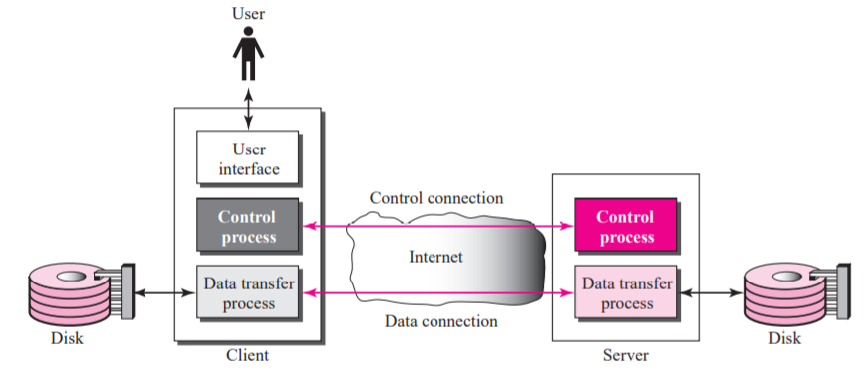
FTP
File Transfer Protocol (FTP) is the standard mechanism provided by TCP/IP for copying a file from one host to another.
FTP uses the services of TCP. It needs two TCP connections.
The well-known port 21 is used for the control connection and the well-known port 20 for the data connection.

Slide 37
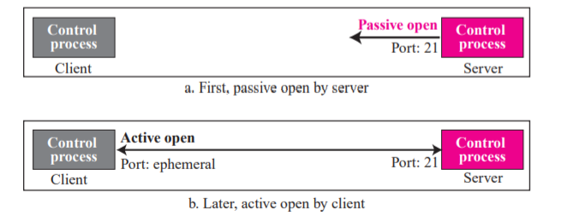
Control Connection
The control connection is created in the same way as other application programs described so far. There are two steps:
The server issues a passive open on the well-known port 21 and waits for a client.
The client uses an ephemeral port and issues an active open.

Slide 38
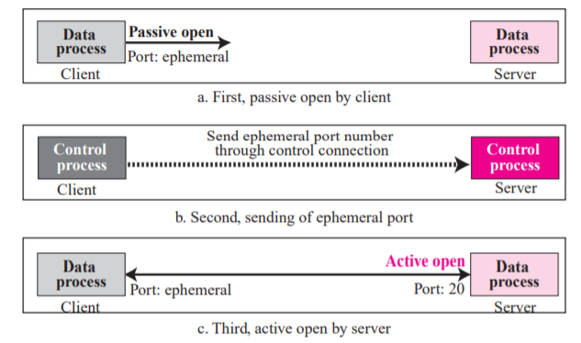
Data Connection
FTP creates a data connection in the following ways:
The client, not the server, issues a passive open using an ephemeral port. This must be done by the client because it is the client that issues the commands for transferring files.
The client sends this port number to the server using the PORT command (we will discuss this command shortly).
The server receives the port number and issues an active open using the wellknown port 20 and the received ephemeral port number.

Slide 39
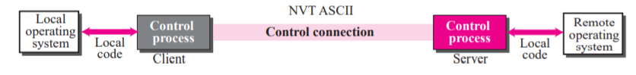
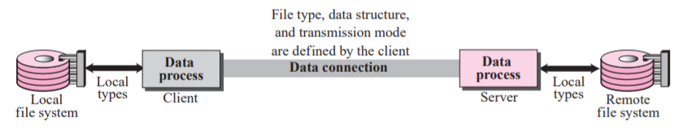
Communication
Two ways
Communication Over Control Connection
Communication Over Data Connection

Slide 40
FTP can transfer one of the following file types across the data connection:
ASCII file. This is the default format for transferring text files. Each character is encoded using NVT ASCII. The sender transforms the file from its own representation into NVT ASCII characters and the receiver transforms the NVT ASCII characters to its own representation.
EBCDIC file. If one or both ends of the connection use EBCDIC encoding, the file can be transferred using EBCDIC encoding.
Image file. This is the default format for transferring binary files. The file is sent as continuous streams of bits without any interpretation or encoding. This is mostly used to transfer binary files such as compiled programs
If the file is encoded in ASCII or EBCDIC, another attribute must be added to define the printability of the file.
Nonprint This is the default format for transferring a text file. This means that the file cannot be printed without further processing because there are no characters to be interpreted for vertical movement of the print head. This format is used for files that will be stored and processed later.
TELNET In this format the file contains NVT ASCII vertical characters such as CR (carriage return), LF (line feed), NL (new line), and VT (vertical tab). The file is printable after transfer.

Slide 41
Data Structure
FTP can transfer a file across the data connection using one of the following interpretations about the structure of the data:
File structure (default). The file has no structure. It is a continuous stream of bytes.
Record structure. The file is divided into records. This can be used only with text files.
Page structure. The file is divided into pages, with each page having a page number and a page header. The pages can be stored and accessed randomly or sequentially.
Transmission mode- three types
Stream mode: default mode. Data are delivered from FTP to TCP as a continuous stream of bytes. TCP is responsible for chopping data into segments of appropriate size. If the data is simply a stream of bytes (file structure), no end-of-file is needed. End-of-file in this case is the closing of the data connection by the sender. If the data are divided into records (record structure), each record will have a 1-byte end-of-record (EOR) character and the end of the file will have a 1-byte end-of-file (EOF) character.
Block mode. Data can be delivered from FTP to TCP in blocks. In this case, each block is preceded by a 3-byte header. The first byte is called the block descriptor; the next two bytes define the size of the block in bytes.
Compressed mode. Big Files. The compression method normally used is run-length encoding. In this method, consecutive appearances of a data unit are replaced by one occurrence and the number of repetitions. In a text file, this is usually spaces (blanks). In a binary file, null characters are usually compressed.

Slide 42
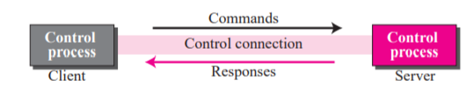
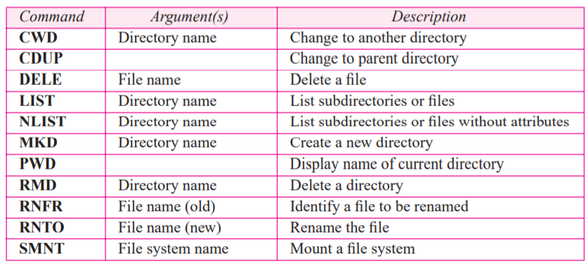
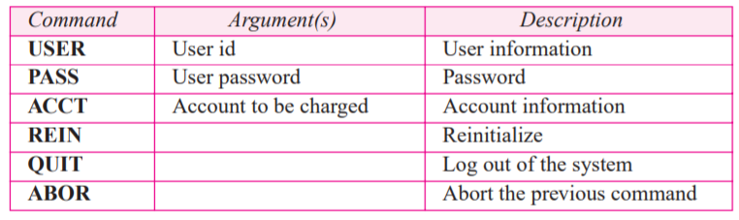
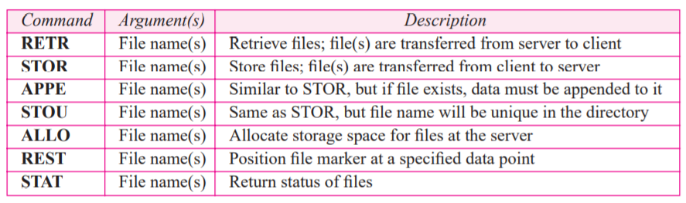
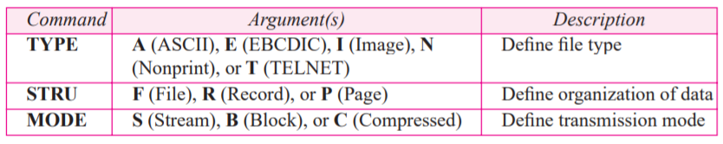


Command Processing
File Management Commands
Access Commands
File transfer commands
Data formatting commands
Miscellaneous commands
Port defining commands

Slide 43


Responses
Responses Every FTP command generates at least one response.
A response has two parts: a three digit number followed by text.
The numeric part defines the code; the text part defines needed parameters or extra explanations.
File Transfer

Slide 44
Anonymous FTP
To use FTP, a user needs an account (user name) and a password on the remote server.
Some sites have a set of files available for public access.
To access these files, a user does not need to have an account or password.
Instead, the user can use anonymous as the user name and guest as the password.
User access to the system is very limited.
Some sites allow anonymous users only a subset of commands.
For example, most sites allow the user to copy some files, but do not allow navigation through the directories.

Slide 45
Security for FTP
The FTP protocol was designed when the security was not a big issue.
Although FTP requires a password, the password is sent in plaintext (unencrypted), which means it can be intercepted and used by an attacker.
The data transfer connection also transfers data in plaintext, which is insecure.
To be secure, one can add a Secure Socket Layer between the FTP application layer and the TCP layer : SSL-FTP.

Slide 46

FTP Vs TFTP

Slide 47






TFTP
TFTP is good for simple file transfers, such as during boot time fits on ROM requires only IP & UDP
No security for TFTP. TFTP can read or write a file for the client
RRQ format
WRQ format
Data format
ACK format
Error format

Slide 48


Error numbers and their meanings
Connection establishment

Slide 49




Server’s apprentice bug
UDP port numbers used by TFTP

Slide 50

TFTP example

Slide 51


It can be used to initialize devices such as bridges or routers.
Its main application is with the DHCP.
TFTP requires only a small amount of memory and uses only the services of UDP and IP.
It can easily be configured in ROM (or PROM).
When the station is powered on, TFTP will be connected to a server and can download the configuration files from there.
The powered-on station uses the DHCP client to get the name of the configuration file from the DHCP server.
The station then passes the name of the file to the TFTP client to get the contents of the configuration file from the TFTP server.
Use of TFTP with DHCP

Slide 52
WWW Architecture

Slide 53
WWW Architecture
WWW is a networked information system (repository of information) and it provides distributed client-server service, in which a client using a browser can access a service using a server.
Sites
Web pages (simple / composite)
Client
Request
Server
Response

Slide 54

Hypertext and Hypermedia
Hypertext –creating a document that in turn refer to other document. In a hypertext document, a part of text can be defined as a link to another document.
Hypermedia is a term applied to document that contains links to other textual document or documents containing graphics, video, or audio.

Slide 55
Web Client (Browser)
It is an application software that allows us to view and explore information on the web. User can request for any web page by just entering a URL into address bar.
Web browser can show text, audio, video, animation and more. It is the responsibility of a web browser to interpret text and commands contained in the web page.
A variety of vendors offer commercial browsers that interpret and display a Web document, and all of them use nearly the same architecture. Each browser usually consists of three parts:
a controller – receives input from keyboard
client protocol – access the document
Interpreters – display document on screen

Slide 57
Web Server
Web site is collection of web pages while web server is a software that respond to the request for web resources.
When client sends request for a web page, the web server search for the requested page if requested page is found then it will send it to client with an HTTP response.
If the requested web page is not found, web server will the send an HTTP response : Error 404 Not found.
A server can also become more efficient through multithreading or multiprocessing. In this case, a server can answer more than one request at a time.
Some popular Web servers include Apache and Microsoft Internet Information Server.

Slide 58

Uniform Resource Locator (URL)
A URL (Uniform Resource Locator) is a unique identifier used to locate a resource on the internet.
Protocol - client-server application program used to retrieve the document (http)
Host - domain name of the computer on which the information is located (www)
Port – (optional) If the port is included, it is inserted between the host and the path, and it is separated from the host by a colon.
Path - pathname of the file where the information is located.

Slide 59

Web Documents

Slide 60

Static Documents
The author of a static document determines the contents at the time the document is written.
Since the contents do not change, each request for a static document results in exactly the same response.
Static documents are prepared using – HTML, XML, XSL, XHTML.

Slide 61

Dynamic Documents
A dynamic web document does not exist in a predefined form.
When a request arrives the web server runs an application program that creates the document.
The server returns the output of the program as a response to the browser that requested the document.
Since a fresh document is created for each request, the contents of a dynamic document can vary from one request to another.
Technologies involved – PHP, JSP, ASP etc.
Dynamic documents are sometimes referred to as server-site dynamic documents.

Slide 62

Active Documents
An active web document consists of a computer program that the server sends to the browser and that the browser must run locally.
When it runs, the active document program can interact with the user and change the display continuously.
Active documents are sometimes referred to as client-site dynamic documents.

Slide 63
HTTP

Slide 64
HTTP
The Hypertext Transfer Protocol (HTTP) is a protocol used mainly to access data on the World Wide Web.
HTTP functions as a combination of FTP and SMTP.
HTTP uses the services of TCP on well-known port 80.

Slide 65

HTTP Transaction
The Hypertext Transfer Protocol (HTTP) is a protocol used mainly to access data on the World Wide Web.
HTTP functions as a combination of FTP and SMTP.
HTTP uses the services of TCP on well-known port 80.
Request message
Request Line

Slide 66

HTTP Transaction (Cont . . .)
Format of request message and response message

Slide 67
Conditional Request
Request based on condition is possible.
If condition is met, server sends it; else client is informed about it.
Example conditions - time and date the Web page is modified.
Request
GET http://www.commonServer.com/information/file1 HTTP/1.1
If-Modified-Since: Thu, Sept 04 00:00:00 GMT
Response
HTTP/1.1 304 Not Modified
Date: Sat, Sept 06 08 16:22:46 GMT
Server: commonServer.com
(Empty Body)

Slide 68
Persistence
HTTP version 1.1 specifies a persistent connection by default.
Connection is left open for more requests.
Connection will be closed only after a request or if a time-out is reached.
Length of data is sent by the sender on each response, but if it is unknown (Dynamic documents) then the server informs client and closes the connection.

Slide 69
Cookies
It is a small piece of data stored in users system by the browser while browsing a website.
When the client receives the response from server on request, the browser stores the cookie in the cookie directory.
Next time, when a client sends a request to a server, the browser looks in the cookie directory to
see if it can find a cookie sent by that server. If found, the cookie is included in the request.
Example – e-commerce

Slide 70
Web caching: Proxy server
Proxy server acts as a gateway between client and server.
It keeps copies of responses to recent requests.
On receiving the request from client, proxy server checks its cache and if it is not found then the request is sent to corresponding server.
This reduces the load on the original server, decreases traffic, and improves latency.
However, to use the proxy server, the client must be configured to access the proxy instead of the target server.

Slide 71
HTTP security
HTTPS provides confidentiality, client and server authentication, and data integrity.

Slide 72
DHCP

Slide 73
Introduction
Every computer that utilizes TCP/IP protocol should know its IP address.
In addition to this, Subnet mask is also needed, if the computer is under a subnet.
The other two information needed for most of the recent machines are
The default router’s address – to interface with other networks
The name server’s address – to use names rather than addresses.

Slide 74
DHCP (Definition)
It is a Client/server protocol to provide the four required parameters to a diskless machine to enable the machine communicate with other networks.

Slide 75
DHCP Operation
The operation is initiated with a broadcasting request by the client depending upon the client and server’s location, which could be any one of the following
Same network - Client and server are present on the same network
Different network - Client and server are present on different network

Slide 76

Same Network

Slide 77
Same network Operation
A open command is provided by the server on UDP port number 67.
Server waits for the client to respond
The server gets the response from the booted client on port number 68
A connection is now established between the source port 67 and destination port 68 by the server acknowledging with either a broadcast or unicast message.

Slide 78

Different network

Slide 79
Different network Operation
As the client is unaware of the server, a DHCP request is broadcasted.
A relay agent (host) is used, as the router discards the broadcasted IP datagram.
This relay agent is aware of the server’s address and hence listens on UDP port 67 for the messages
The received message is enfold in a unicast datagram (with the destination address) and sent to the server by the relay.
It reaches the server through any router

Slide 80

UDP ports

Slide 81
UDP Ports
Port 67 - used by server (Common)
Port 68 - used by client (to overcome the demultiplexing issue)
Consider the below scenario
Host A uses DHCP client
Host B uses DAYTIME client
(both are in the same network and uses ephermal port 2017)
A broadcast message is sent from the server as an acknowledgement

Slide 82
UDP ports (Contd..)
This message contains the destination port 2017 and broadcast IP address FFFFFFFF16
Host A finds a message from application program on 2017
A correct message and incorrect message is delivered to DHCP and DAYTIME clients respectively
Transaction ID is also used to identify the clients which avoids the confusion created.

Slide 83
TFTP
It is an acknowledgement from the server, containing the pathname of a file which has the complete booting information.

Slide 84
Error control
To take a control over the lost or damaged response, DHCP requires
Checksum
Retransmission
To prevent traffic jam (Created by retransmission)
Random numbers for timers are used

Slide 85

Packet Format

Slide 86
Packet Format (Contd..)
Operation code (8 bit) – Variant of DHCP
Hardware type (8 bit) - variant of physical network
Hardware length (8 bit) - length of physical address in bytes
Hop count (8 bit) - Maximum number of hops
Transaction ID (4 byte) - To match a reply with the request

Slide 87
Packet Format (Contd..)
Number of seconds (16 bit) – Time elapsed to boot the client
Flag (16 bit) – left-most bit is used leaving the remaining bits to be zero.
Client IP address (4 byte) – holds client’s IP address
Server IP address (4 byte) - holds server’s IP address

Slide 88
Packet Format (Contd..)
Gateway IP address (4 byte) – holds router’s IP address
Client Hardware address – Client’s physical address
Server name (64 byte) – holds server’s domain name
Boot file name (128 byte) – Holds path name
Options (64 byte) – carries either vendor information or other additional information.

Slide 89
CONFIGURATION

Slide 90
Static address allocation
A database is used to match physical address to IP address.
DHCP is backward compatible in this case

Slide 91
Dynamic address allocation
An additional database containing the unused IP addresses.
On request from a client, an IP address (temporary ) from this database is allocated to the requesting client on lease.
This is based on the entry in the static database.
This allocation is essential when there is a transfer of host from one network to another.

Slide 92
Transition states
To enable dynamic address allocation, the machine passes through several transitions
The type of the transition is indicated tag 53.

Slide 93
States
INIT state – Client initiates by sending DHCPDISCOVER message
SELECTING STATE – SERVERS offers DHCPOFFER message. Client has to select one among the offers. Client sends DHCPREQUEST message to the selected server.
REQUESTING STATE – Until the client receives DHCPACK message, it stays in the same state

Slide 94
States (Contd..)
BOUND STATE – Client uses the IP address until the lease expires. DHCPREQUEST is again initiated by the client to renew the lease when 50% of the lease period is expired.
RENEWING STATE – If DHCPACK is received, client gets back to BOUND state otherwise enters into the REBINDING state after 87.5% of time expires

Slide 95
States (Contd..)
REBINDING STATE – The client does the following
DHCPNACK / lease expired – Client goes to the initializing state and gets new IP address.
DHCPACK – It goes to the bound state – resets timer.

Slide 96
E - Mail: SMTP, POP, IMAP, and MIME

Slide 97
Discussion On
Architecture
User agent
Message transfer agent
Message access agent
MIME

Slide 98
Architecture
We have 4 scenarios in explain the architecture of e-mail.
First Scenario
Second Scenario
Third Scenario
Fourth Scenario

Slide 99



First scenario
The sender and the receiver of the e-mail are users on the same mail server; they are directly connected to a shared mail server.
The admin has created one mailbox to store the received messages. Only the sender or the receiver of the mailbox has access to it.

Slide 100
First scenario(Contd..)
When Alice needs to send a message to Bob, she runs a user agent( is a program) to prepare the message and store it in Bob’s mailbox.
The message has the sender and recipient mailbox addresses. Bob can retrieve and read the contents of his mailbox at his convenience using a user agent.

Slide 101






Second scenario

Slide 102
Second scenario (Contd..)
Here, the sender and the receiver of the e-mail are users on two different mail servers. The message needs to be sent over the Internet. Here we need user agents (UAs) and message transfer agents (MTAs)
Alice needs to use a user agent to send her message to the mail server at her own site. The mail server at her site uses a buffer (queue) to store messages waiting to be sent.
Bob also needs a user agent to retrieve messages stored in the mailbox of the system at his site. Here two message transfer agents are needed: one client and one server.
The server needs to run all of the time because it does not know when a client will ask for a connection. The client, on the other hand, can be triggered by the system when there is a message in the queue to be sent.

Slide 103








Third scenario

Slide 104
Third scenario (Contd..)
Alice needs a user agent to prepare her message. She then needs to send the message through the LAN or WAN.
This can be done through a pair of message transfer agents (client and server). Whenever Alice has a message to send, she calls the user agent which, in turn, calls the MTA client.
The MTA client establishes a connection with the MTA server on the system, which is running continuously. The system at Alice’s site queues all messages received.
It then uses an MTA client to share the messages to the system at Bob’s site; the system receives the message and stores it in Bob’s mailbox.

Slide 105










Fourth scenario

Slide 106
Fourth scenario (Contd..)
Here, Bob is also connected to his mail server by a WAN or a LAN. After the message has arrived at Bob’s mail server, Bob needs to retrieve it.
Here, we need another set of client-server agents, which we call message access agents (MAAs).
Bob uses an MAA client to retrieve his messages. The client sends a request to the MAA server, which is running all the time, and requests the transfer of the messages.
Bob cannot bias the mail server to use the MTA server directly. To use the MTA server directly, Bob would need to run the MTA server all the time because he does not know when a message will arrive.

Slide 107


Push vs Pull
Here, Bob needs another pair of client-server programs: message access programs. This is because an MTA client-server program is a push program:
The client pushes the message to the server. Bob needs a pull program. The client needs to pull the message from the server.

Slide 108
User Agent
The first component of an electronic mail system is the user agent (UA). It provides service to the user to make the process of sending and receiving a message easier.
Services Provided by a User Agent
User Agent Types
Sending Mail
Receiving Mail
Addresses
Mailing List or Group List

Slide 109
Message transfer agent
The actual mail transfer is done through message transfer agents (MTAs). To send mail, a system must have the client MTA, and to receive mail, a system must have a server MTA.
The formal protocol that defines the MTA client and server in the Internet is called Simple Mail Transfer Protocol (SMTP).

Slide 110

SMTP range

Slide 111
SMTP range (Contd..)
SMTP is used two times, between the sender and the sender’s mail server and between the two mail servers. SMTP defines how commands and responses must be sent back and forth

Slide 112

Commands and responses
SMTP uses commands and responses to transfer messages between an MTA client and an MTA server.

Slide 113

Commands
Commands are sent from the client to the server.

Slide 114

Responses
Responses are sent from the server to the client. A response is a three-digit code that may be followed by additional textual information.

Slide 115

Connection establishment
The server sends code 220 to tell the client that it is ready to receive mail.
The client sends the HELO message to identify itself using its domain name address. This step is necessary to inform the server of the domain name of the client.
The server responds with code 250

Slide 116
Mail Transfer
The client sends the message to introduce the sender of the message. It includes the mail address of the sender. This step is needed to give the server the return mail address for reporting messages.
The server responds with code.
The client sends the message, which includes the mail, that address of the recipient.
The server responds with code.
The client sends the DATA message to initialize the message transfer.
The server responds with code to start mail input.
The client sends the contents of the message in consecutive lines. Each line is terminated by a two-character end-of-line token.
The server responds with code.

Slide 117

Mail transfer

Slide 118

Connection termination
When the message is transferred successfully, the client terminates the connection.

Slide 119

Message access agent
The first and the second stages of mail delivery use SMTP. Here, SMTP is not involved in the third stage because SMTP is a push protocol; it pushes the message from the client to the server.
The third stage needs a pull protocol; the client must pull messages from the server. The direction of the bulk data are from the server to the client.
The third stage uses a message access agent. Currently two message access protocols are available: Post Office Protocol, version 3 (POP3) and Internet Mail Access Protocol, version 4 (IMAP4).

Slide 120
POP3 & IMAP4
POP3(Post Office Protocol, version 3):
The client POP3 software is installed on the recipient computer; the server POP3 software is installed on the mail server. Mail access starts with the client when the user needs to download its e-mail from the mailbox.
The client opens a connection to the server on TCP port. It then sends its user name and password to access the mailbox. The user can then list and retrieve the mail messages, one by one.

Slide 121
POP3 & IMAP4 (Contd..)
IMAP4(Internet Mail Access Protocol, version 4): It is more powerful and more complex.
IMAP4 provides the following extra functions:
A user can check the e-mail header prior to downloading.
A user can search the contents of the e-mail for a specific string of characters prior to downloading.
A user can partially download e-mail. This is especially useful if bandwidth is limited and the e-mail contains multimedia with high bandwidth requirements.
A user can create, delete, or rename mailboxes on the mail server.
A user can create a hierarchy of mailboxes in a folder for e-mail storage.

Slide 122

MIME
E - mail has a simple structure. It can send messages only in NVT 7-bit ASCII format. Multipurpose Internet Mail Extensions (MIME) is a supplementary protocol that allows non-ASCII data to be sent through e-mail.
MIME transforms non-ASCII data at the sender site to NVT ASCII data and delivers it to the client MTA to be sent through the Internet.
The message at the receiving site is transformed back to the original data.

Slide 123

MIME header

Slide 124
MIME header (Contd..)
MIME-Version: This header defines the version of MIME used. The current version is 1.1.
Content-Type :
This header defines the type of data used in the body of the message. The content type and the content subtype are separated by a slash.
Depending on the subtype, the header may contain other parameters.

Slide 125

Data Type and Subtype in MIME

Slide 126

Content Transfer Encoding
Content-Transfer-Encoding: This header defines the method used to encode the messages into 0s and 1s for transport:
The five types of encoding methods are listed

Slide 127
References (finishing slides covering references for all the topics)
Douglas E. Comer, Internetworking with TCP/IP, Principles, protocols, and architecture,Vol 1 5th Edition,2006 ISBN: 0131876716, ISBN: 978-0131876712 (Ref 2 in syllabus)
https://slideplayer.com/slide/13911208/
http://www.csun.edu/~jeffw/Semesters/2006Fall/COMP429/Presentations/Ch25-FTP.pdf
https://study.com/academy/lesson/testing-an-ftp-connection.html
www.afternerd.com/blog/smtp
18CSC302J- School of Computing (Odd sem 2020)

